Slide 1


LOYOLA-ICAM COLLEGE OF ENGINEERING AND TECHNOLOGY (LICET) Loyola Campus, Nungambakkam, Chennai – 600034
TWITTER SENTIMENT ANALYSER
DONE BY: SUPERVISOR:
Amala Lily Carolin 311119104008 Sharmila V J AP/CSE
Joy Infanta 311119104035
Judes Jovina 311119104036
Mary Derlin Tanya 311119104043
Batch: 2019- 2023

Slide 2
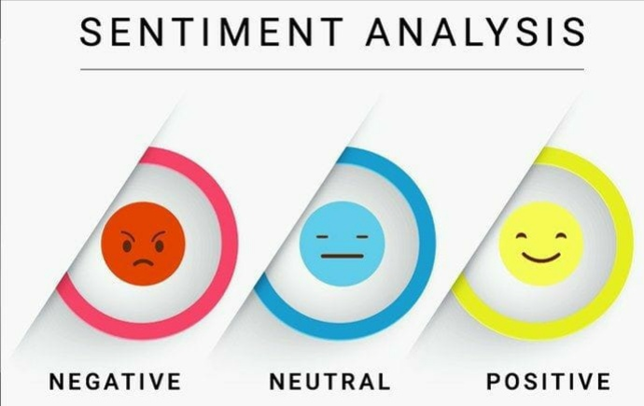
PROBLEM STATEMENT
To help companies understand their customer, traders, investors and make valuable improvements in their products by the companies and to identify the polarity of given text as negative, positive or neutral sentiments.

Slide 3
OBJECTIVE
We have designed a model in a view of analyzing the customer review and feedback by using Twitter API because twitter is one of the largest social network, great community of professional companies and people could give you great variability of data

Slide 4
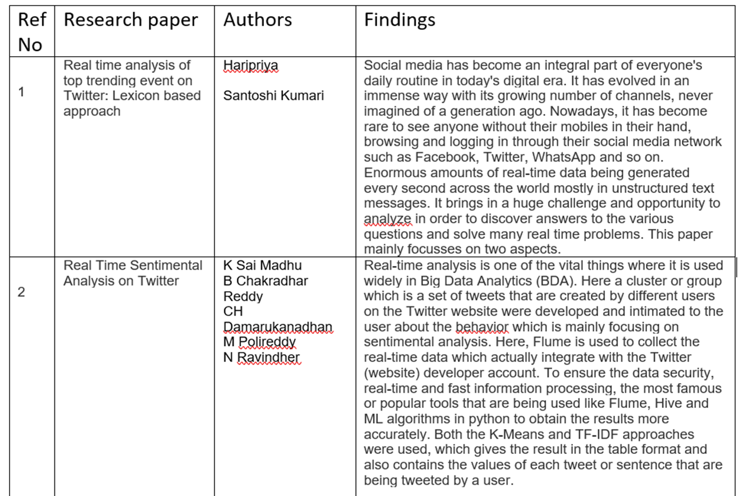
LITERATURE SURVEY

Slide 5
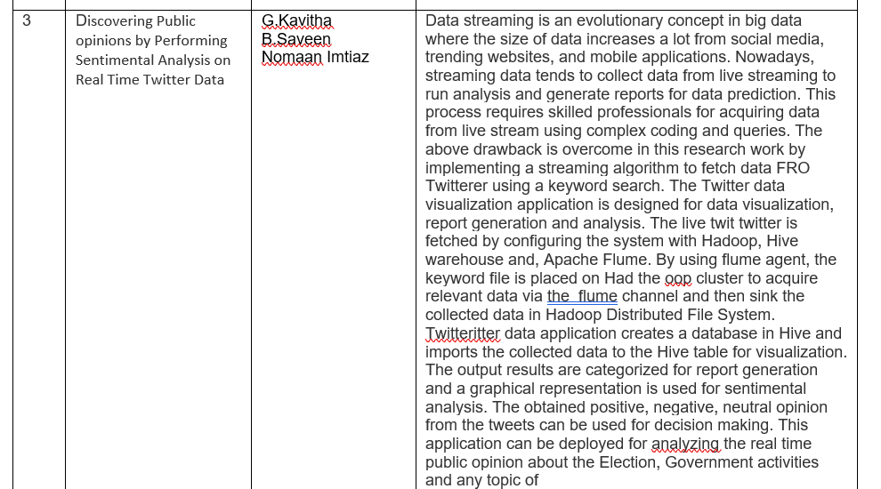

Slide 6
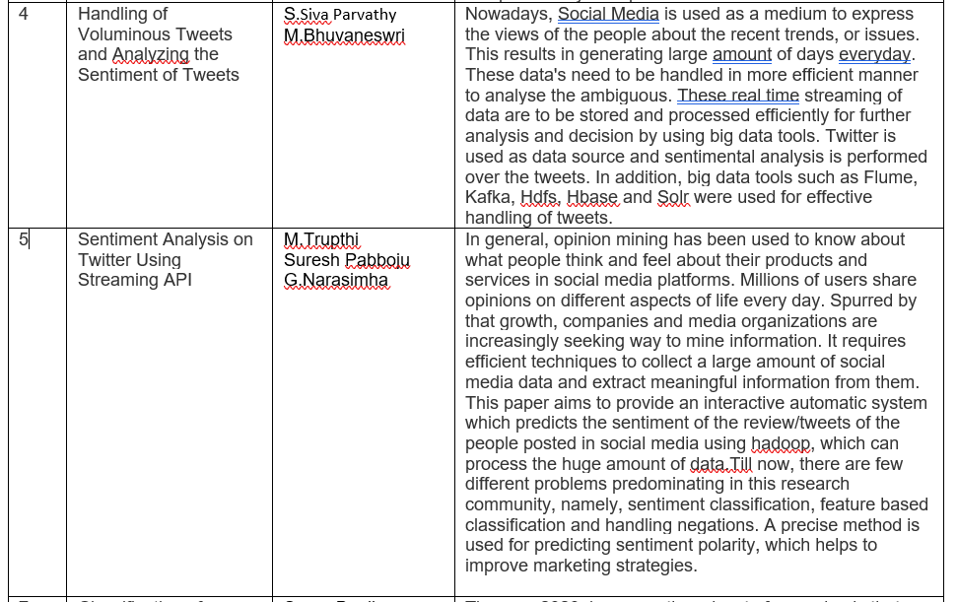

Slide 7
SYSTEM REQUIREMENTS
HARDWARE:
Processor :Intel(R) Core(TM) i3-6006U CPU @2.00GHz 2.00 GHz
Installed RAM : 4.00 GB
System type : 64-bit operating system, x64-based processor
SOFTWARE:
Windows 10
Python platform
NLTK package
Modern web browser
Twitter API

Slide 8
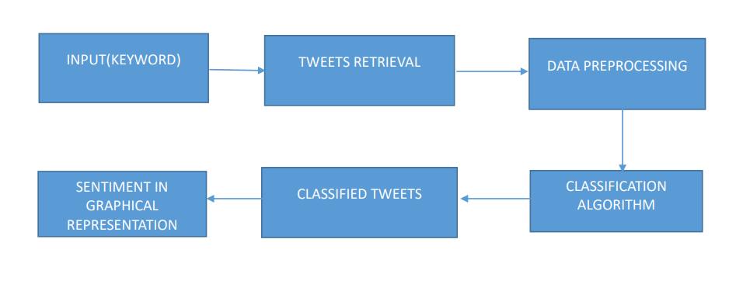
SYSTEM ARCHITECTURE

Slide 9
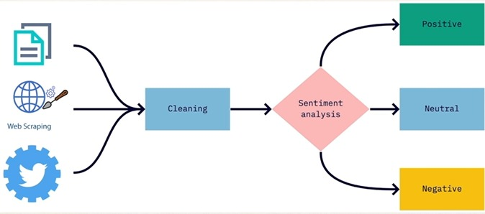
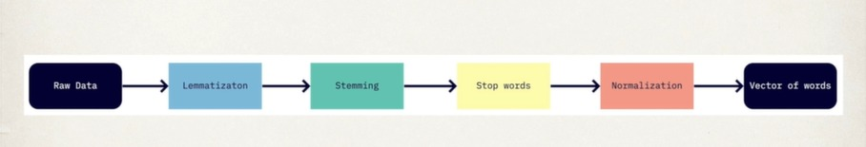
CLEANING :

Slide 10
ANALYZED OUTPUT
Word Cloud
Bar Graph
Pie Chart

Slide 11
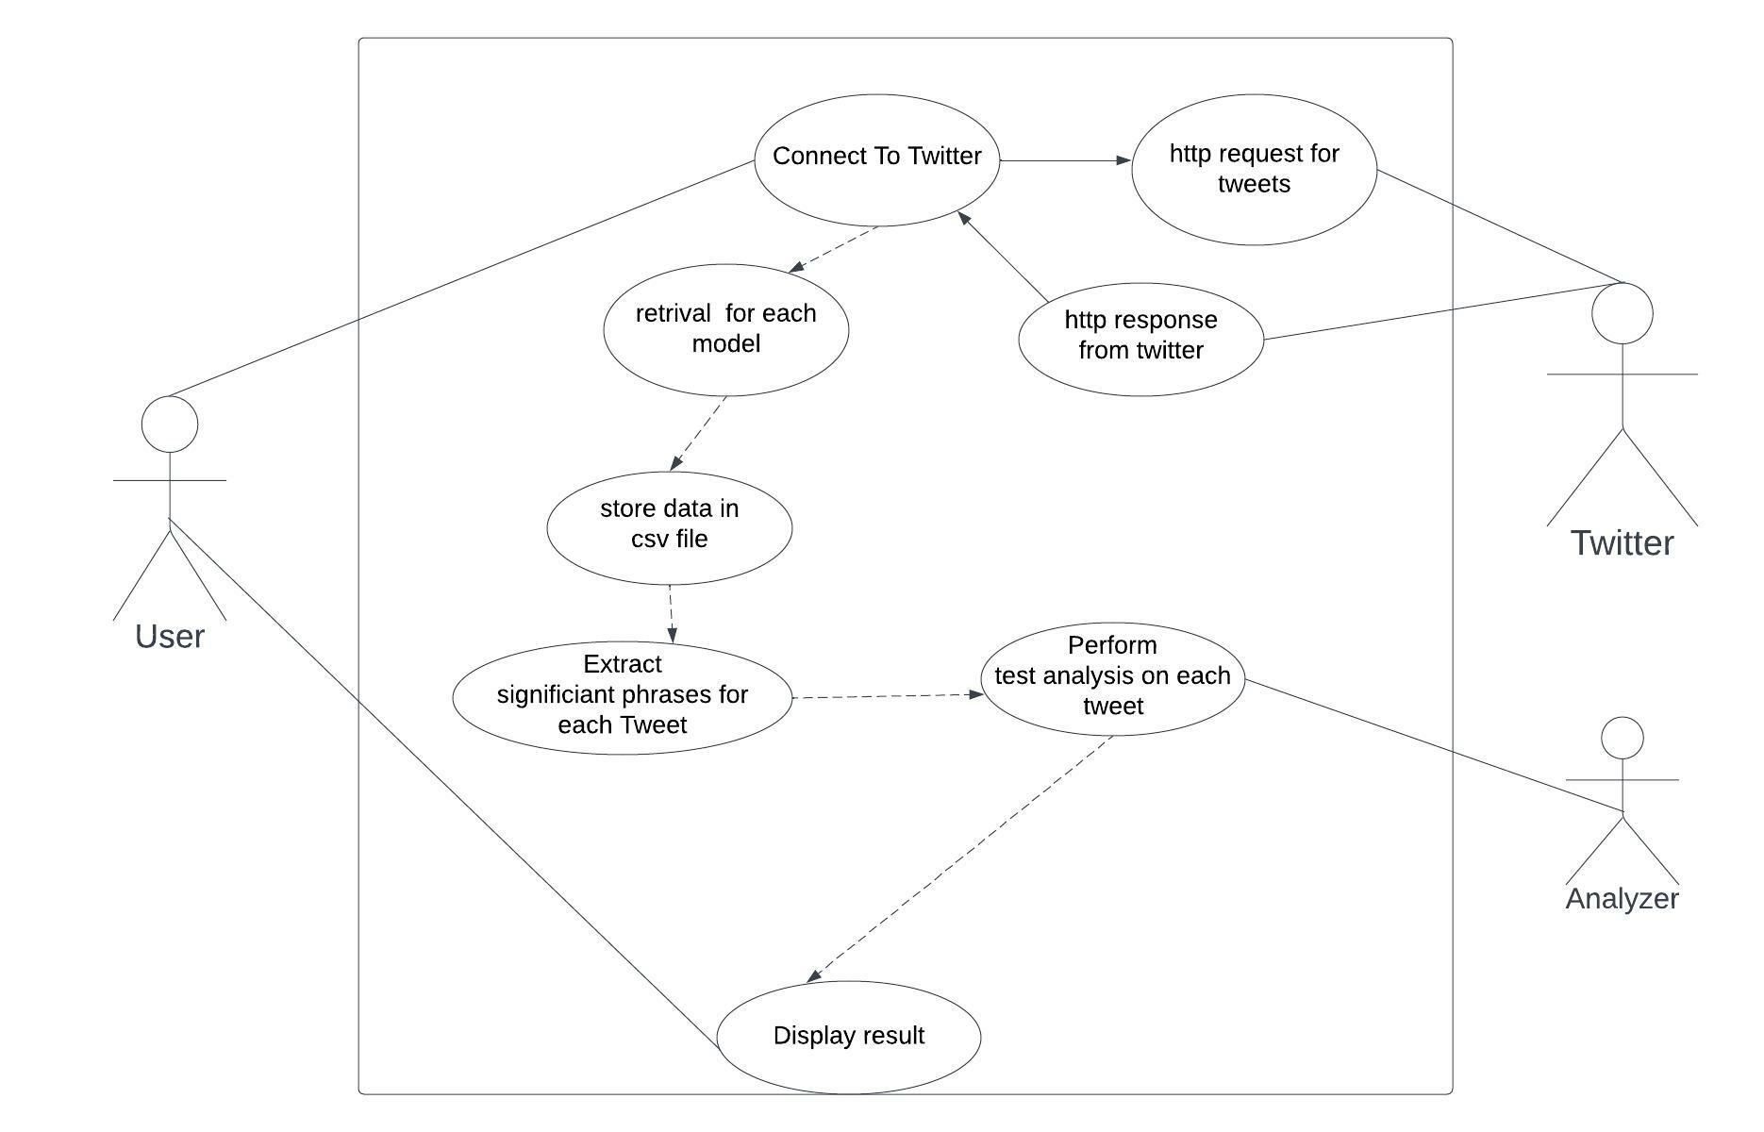
UML DIAGRAMS
USE CASE DIAGRAM

Slide 12
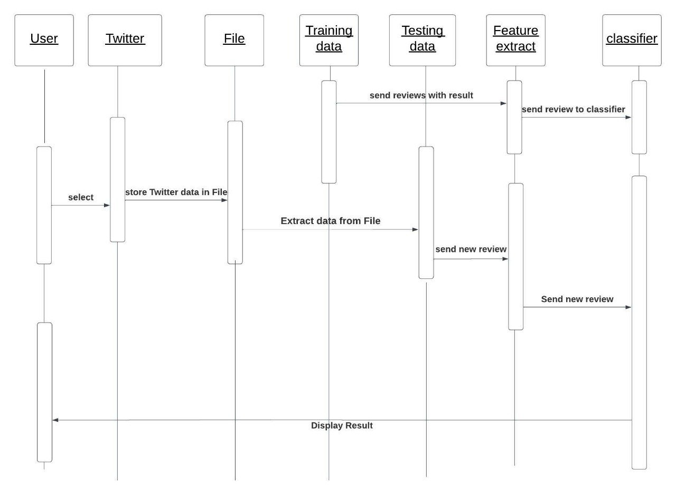
SEQUENCE DIAGRAM

Slide 13
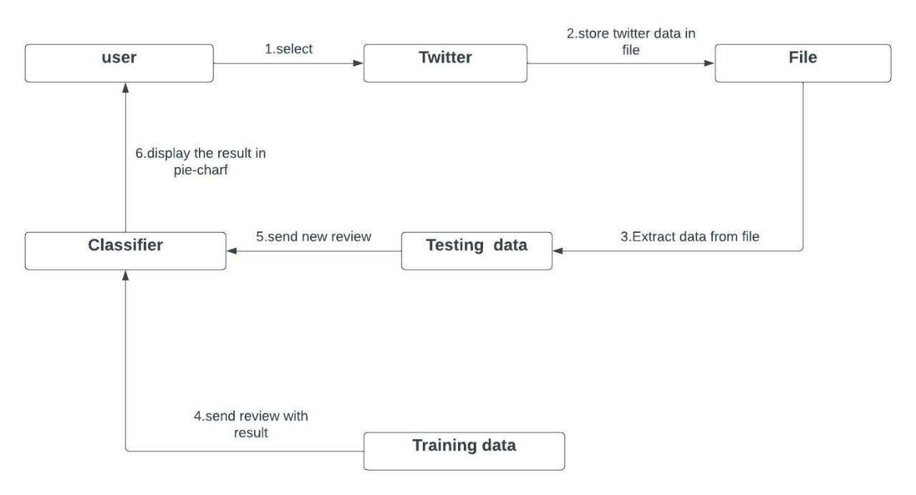
COLLABORATION DIAGRAM

Slide 14
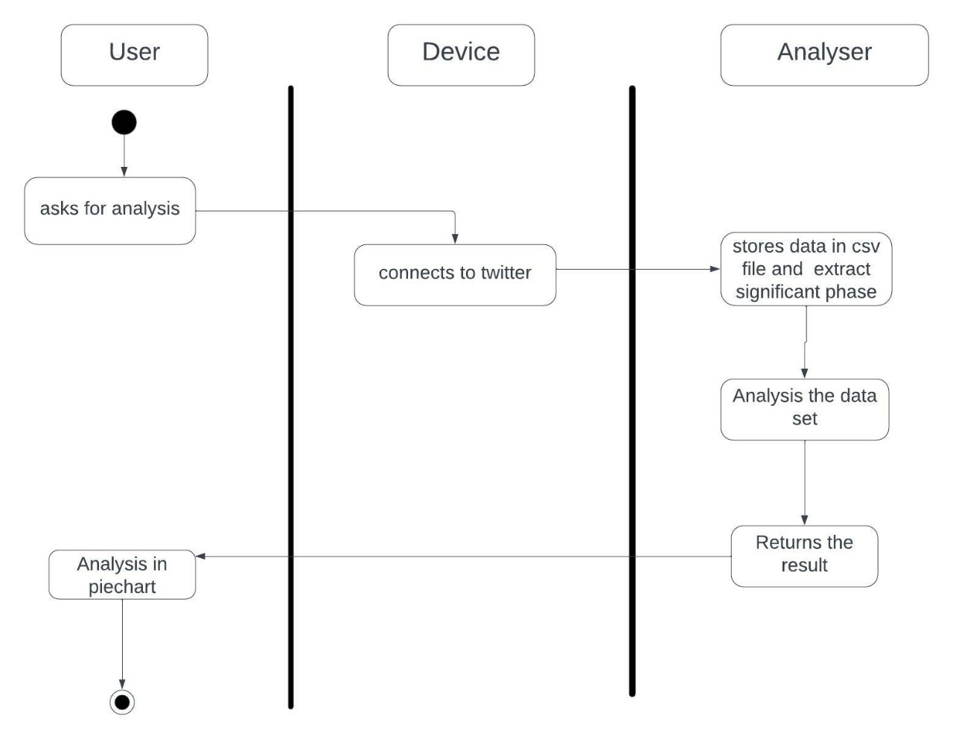
ACTIVITY DIAGRAM

Slide 15
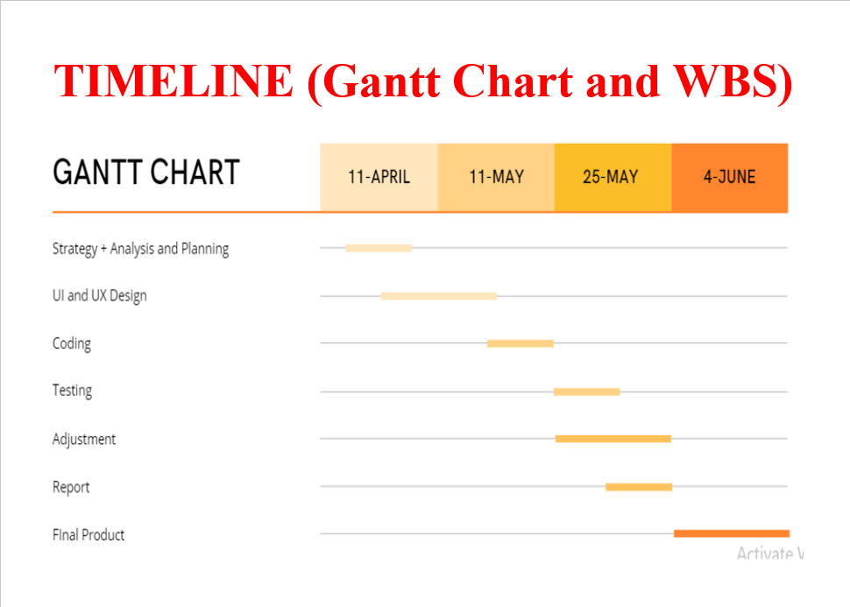

Slide 16
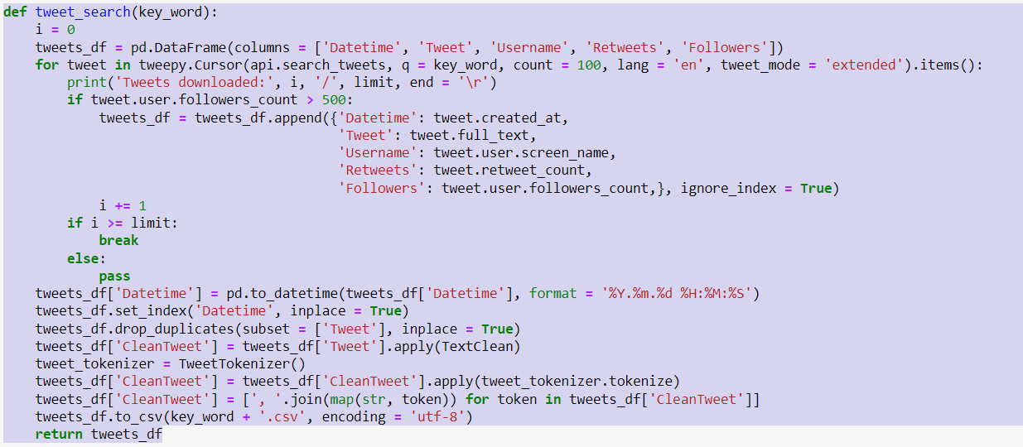
TWEET SEARCH

Slide 17
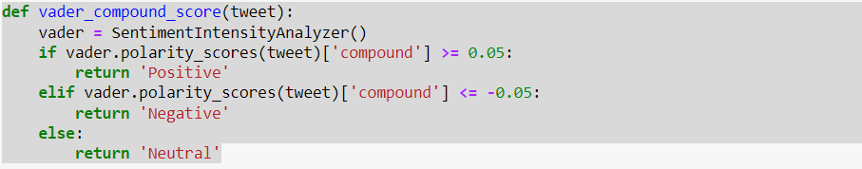
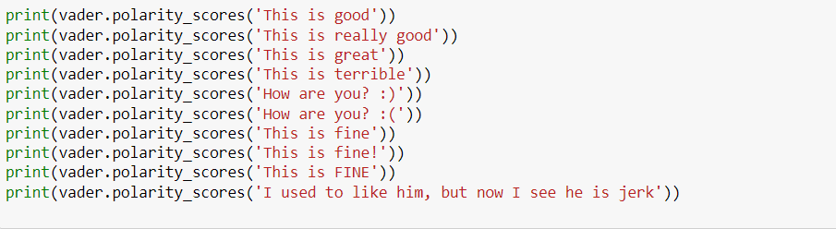
CLASSIFICATION

Slide 18
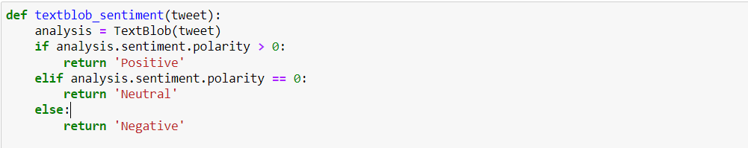
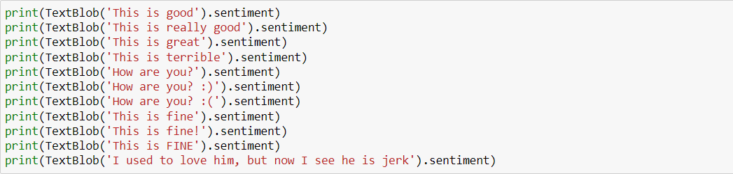
CLASSIFICATION

Slide 19
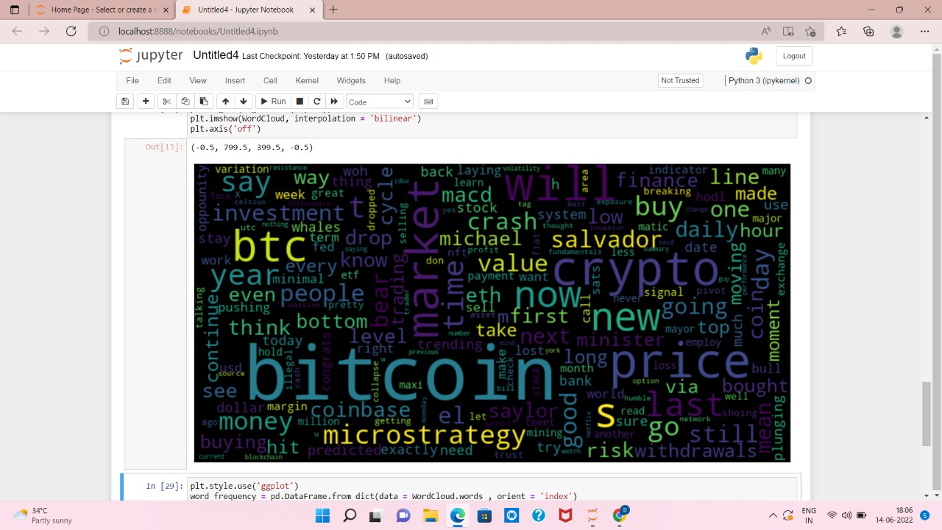
OUTPUT

Slide 20
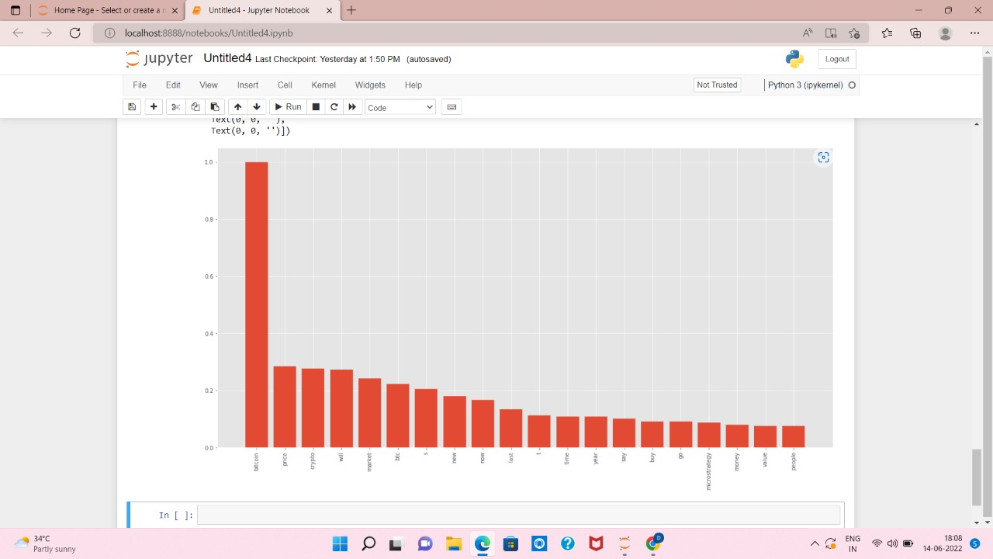
OUTPUT

Slide 21
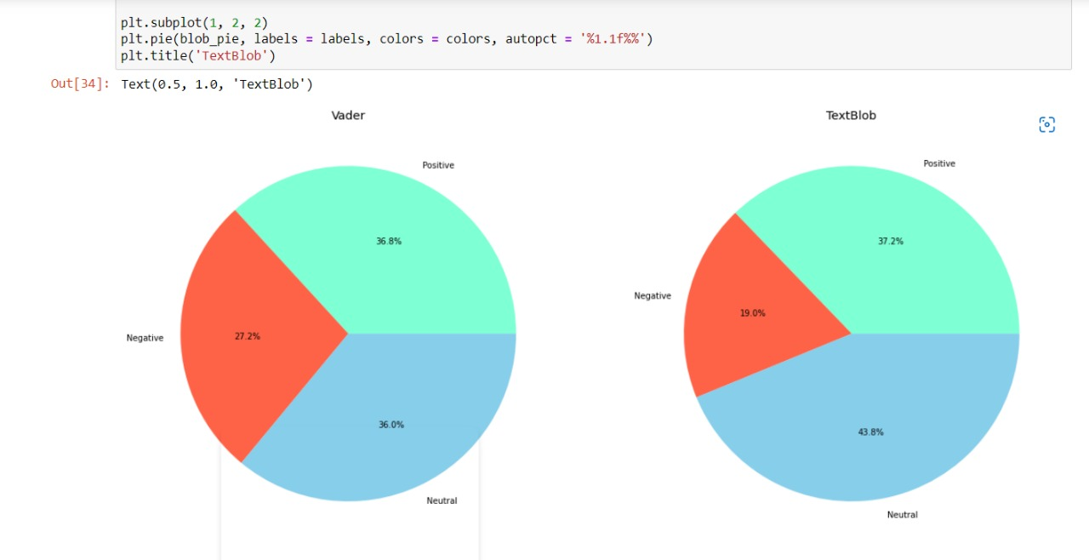

Slide 22
Thank you

